Slide 1
Smart Home Iot final project
Abhishek Chawla: 2019102020
Pragya Singhal: 2019112001
Pranjali Pathre: 2019112002
Sasanka GRS: 2019112017

Slide 2
Motive
The main motive behind this project is to create a system where we can access the devices in one part of the world from any other place and save energy wherever we can!!
IoT has given the world the strength to make smart technologies and we here at IIIT Hyderabad are trying to make one such :)

Slide 3
The two elements of our project…
Smart Security
Smart Street Lights
This element has 2 sub-parts which are designed as a part of the long-distance project - one is the Smart Intruder alert and other is the Smart door lock.
Smart intruder alert – The owner will get an alert as soon as an intruder is sensed.
Smart door lock – The owner can open or close the door from any part of the world.
The smart street lights technology is build to save energy.
The street lights will be alternatively labelled as even/odd batch and only one out of them will glow at a time.
As soon as the temperature of one batch of lights goes past a specific value, that batch will be automatically switch off and other will glow.

Slide 4
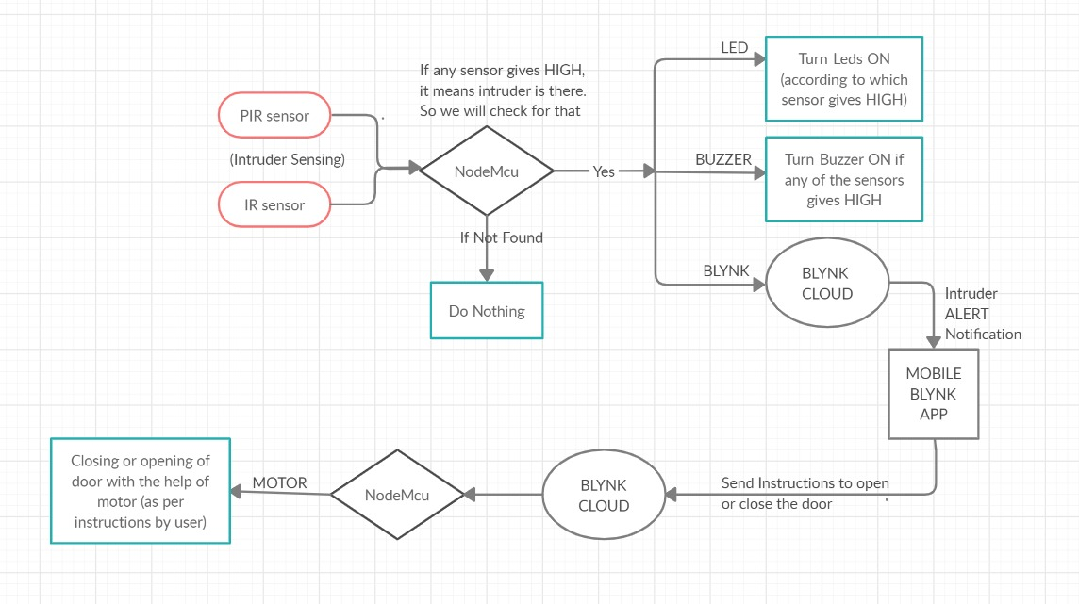

Slide 5
Timeline
We had initially thought of making a smart railway track but because it was a trivial project and didn’t account for a good project, we changed it to the smart security system :)
We have worked together on all the aspects and here’s our demo to the Final Project….

Slide 6
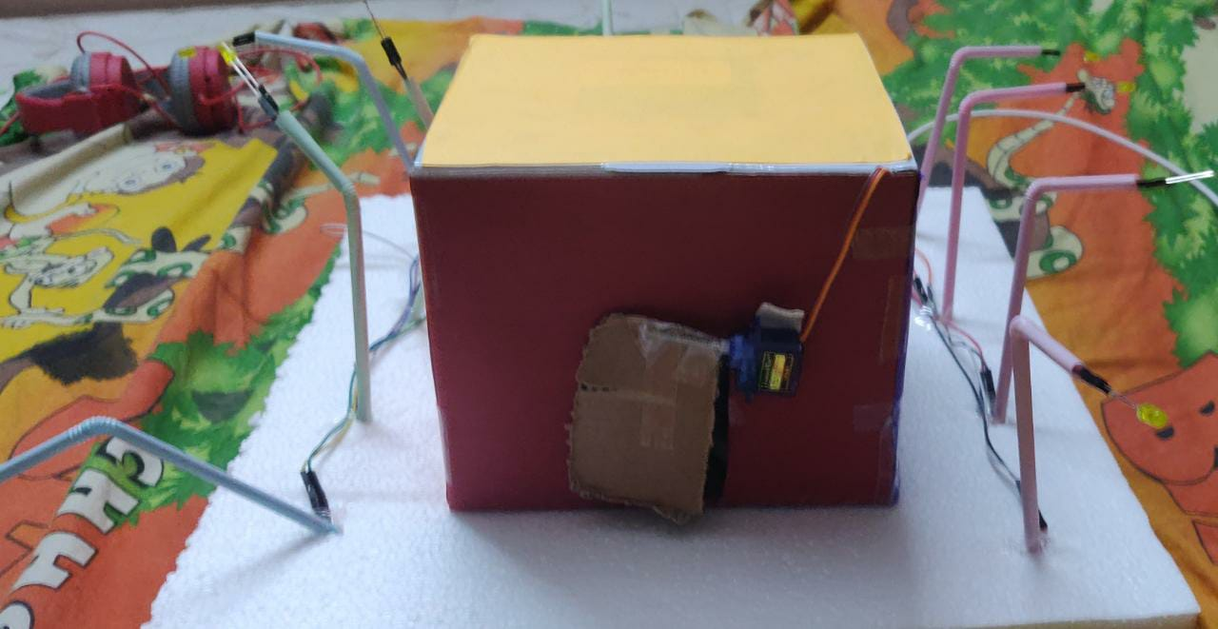
Hardware

Slide 7
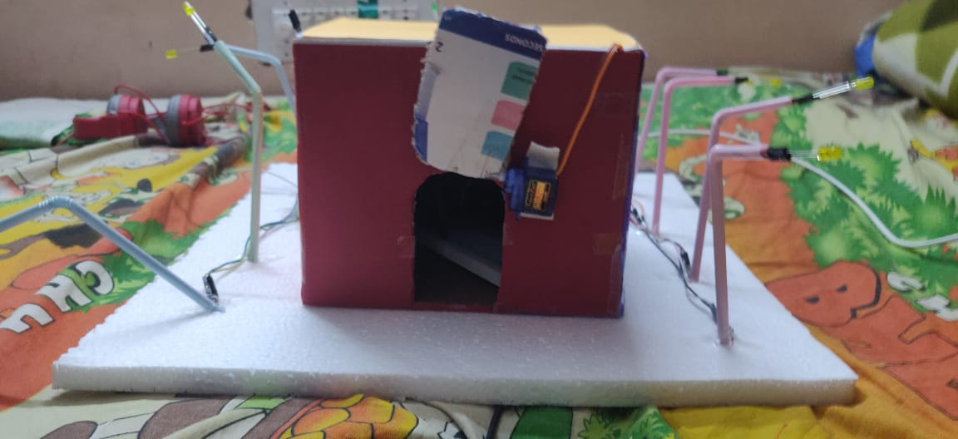
Hardware

Slide 8
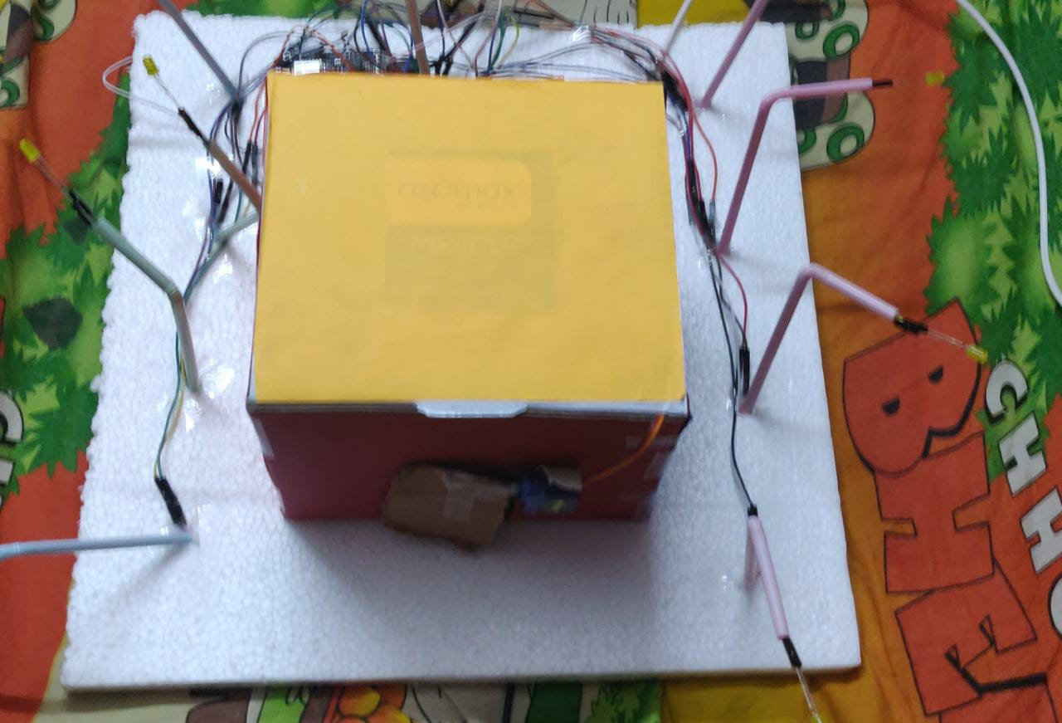
Hardware

Slide 9
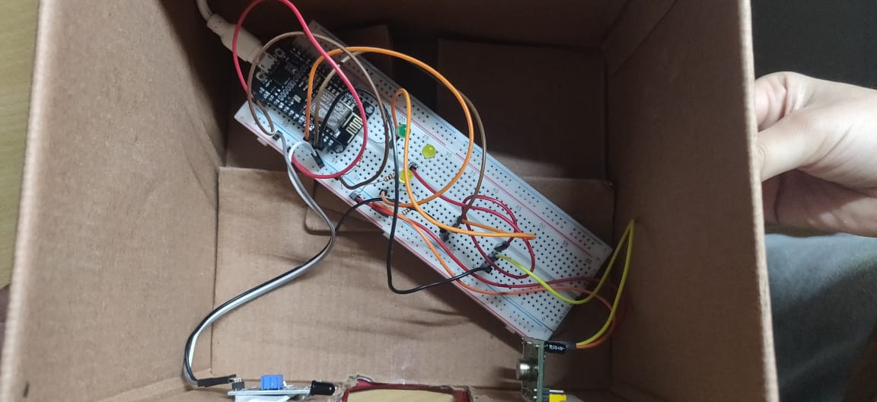
Hardware

Slide 10
Link
https://drive.google.com/file/d/1tKh1xr5SDjI13mKMuPd35AuC9DG4vDss/view?usp=sharing

